Slide 1

Truba Institute of Engineering & Information
Technology, Bhopal
A PRESENTATION ON
Crop Yield Prediction
Presented By
Suman Kumar Saurabh
0114AD233D09
Lalit Kumar
0114AD233D05
Rahul Kumar
0114AD233D07
Guided By
Geeta Guwalani
CSE
Department of Computer Science & Engineering

Slide 2

Contents
Introduction
Objective & Motivation
Problem Identification
Proposed Work
Implementation Details
Result/Expected Outcomes
Conclusion

Slide 3
Introduction
Agriculture is the backbone of the global economy, yet farmers face increasing challenges due to unpredictable weather conditions, changing environmental factors, and the need for efficient resource allocation.
Project Area:
The project focuses on the integration of Machine Learning into agriculture to predict crop yields accurately.
3

Slide 4
Objective & Motivation
Objectives:
Build a system that predicts crop yields based on environmental and agricultural factors.
Provide actionable insights to farmers to optimize resource utilization.
Promote sustainable agricultural practices using technology.
Motivation:
Address challenges of traditional prediction methods.
Improve agricultural efficiency and profitability.
Support food security through data-driven decision-making.
4

Slide 5
Problem Identification
Current Problems:
Traditional methods rely on static historical averages and lack precision.
Inefficient use of resources like water and fertilizers.
Inability to predict yield accurately due to changing environmental conditions.
Solution:
A machine learning model that integrates multiple environmental and agricultural factors to provide accurate crop yield predictions.
5

Slide 6
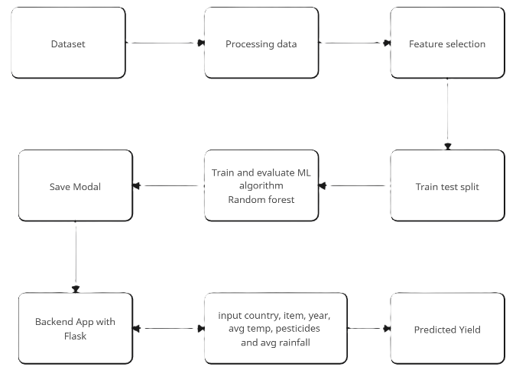
Proposed Work
Proposed System:
A web-based platform that predicts crop yield based on inputs like region, crop type, year, rainfall, temperature, and pesticide usage.
Flowchart:
6

Slide 7
Implementation Details
Techniques Used:
Machine Learning Model: Random Forest Regressor for yield prediction.
Categorical Data Encoding: OrdinalEncoder for region and crop type.
Frameworks & Tools:
Python, Scikit-learn, Flask, Pickle (model serialization).
Frontend: HTML, CSS, JavaScript.
Software Requirements:
Python 3.9+, Flask, and compatible web browsers.
Hardware Requirements:
Minimum 4GB RAM and 20GB storage.
7

Slide 8
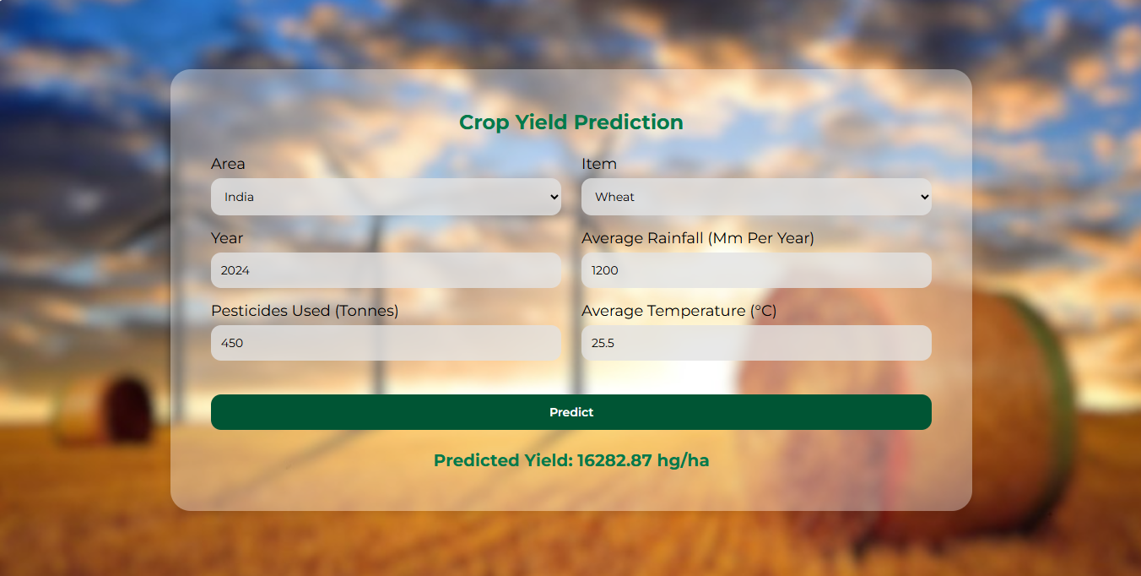
Result/Expected Outcomes
Screenshot
8

Slide 9
Conclusion
The Crop Yield Prediction System demonstrates how machine learning can optimize agricultural practices.
By accurately predicting crop yields, the system helps farmers allocate resources effectively and plan cultivation strategies.
With high accuracy and usability, the project showcases the transformative potential of technology in agriculture, promoting sustainability and efficiency.
9

Slide 10

THANK YOU

